Slide 1
Crop Production Analysis in India
Ansh Gupta

Slide 2
PROBLEM STATEMENT
The Agriculture business domain, as a vital part of the overall supply chain, is expected to highly evolve in the upcoming years via the developments, which are taking place on the side of the Future Internet. This paper presents a novel
Business-to-Business collaboration platform from the agri-food sector perspective, which aims to facilitate the collaboration of numerous stakeholders belonging to associated business domains, in an effective and flexible manner.

Slide 3
OBJECTIVE
Find key metrics and factors and show the meaningful relationships between attributes. Do your own research and come up with your findings

Slide 4





PROCESS
Step 1
Step 2
Step 3
Step 4
Step 5
Data Collection
Data Pre-Processing
Exploratory Data Analysis (EDA)
Finding Insights
Tableau Dashboard

Slide 5
DATASET INFORMATION
This dataset includes season-wise and year-wise data of crop production in India for comprehensive production analysis from 1991-2015.

Slide 6
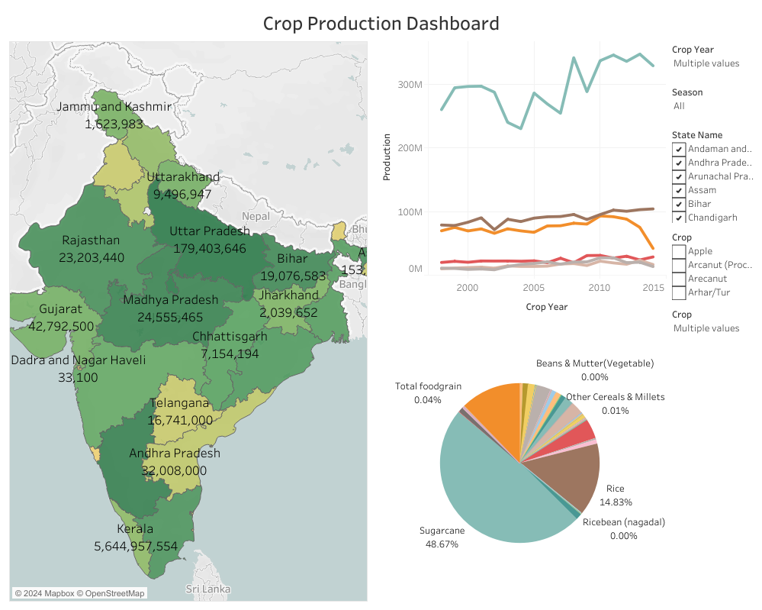

Slide 7
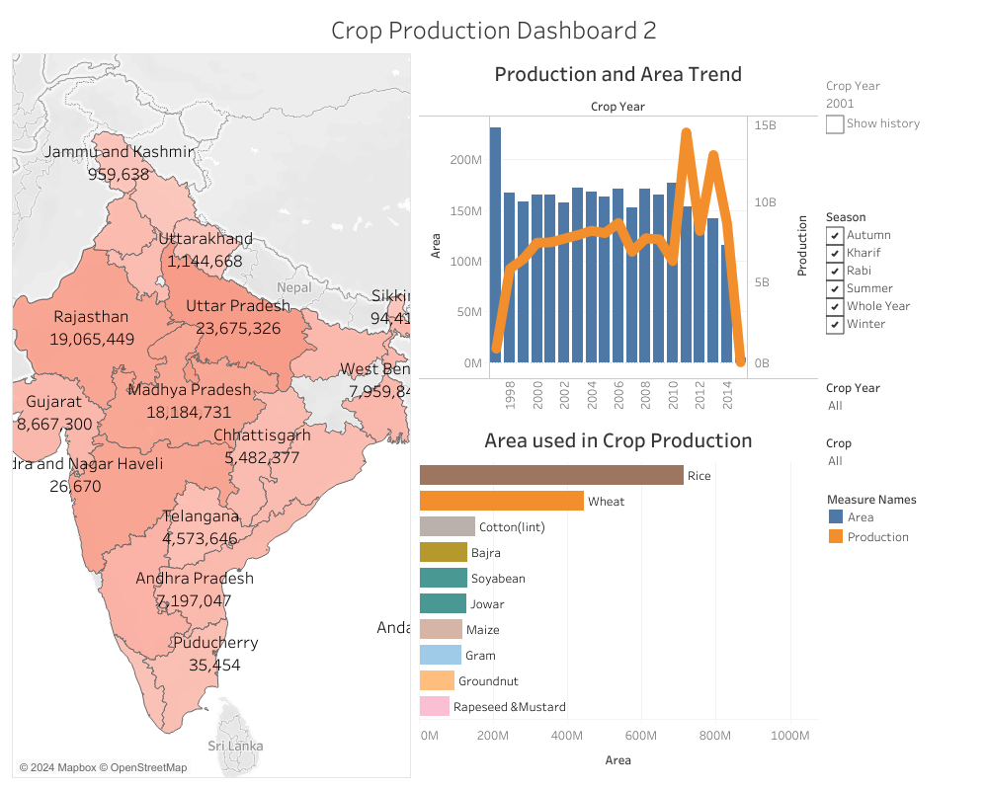

Slide 8
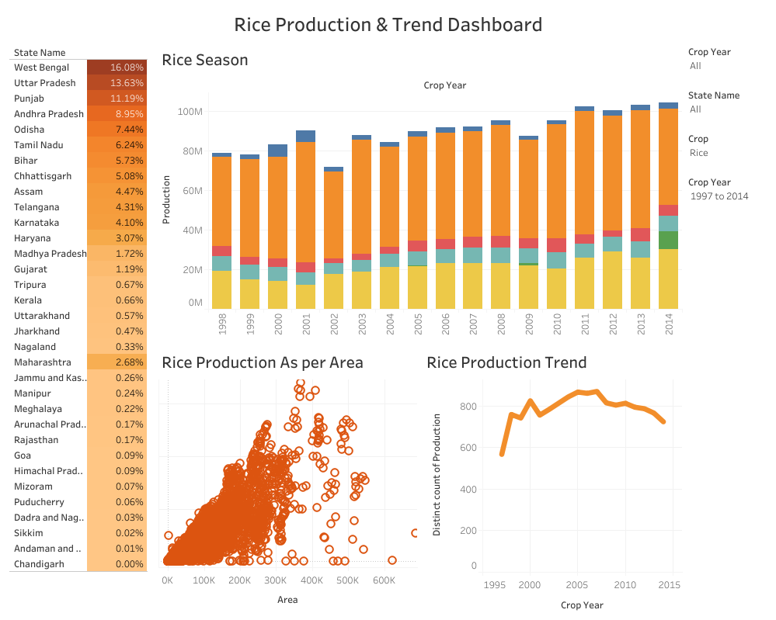

Slide 9
AREAS OF FOCUS
Top Crop Types by Production: Coconut, Sugarcane, and Rice.
Yearly Production Trends: Peak years observed in 2011 and 2013.
Seasonal Production Overview: High production noted in Whole Year (Annual), Kharif, and Rabi crops, indicating reliance on seasonal monsoons.
Key Crop Categories: Cereals, Pulses, and Oilseeds.
State-wise Production Patterns: Kerala dominates Whole Year crops, while Uttar Pradesh excels in Kharif, Rabi, and Summer crops.
Crop Category Proportions: Cereals (27.5%), Pulses (17.8%), and Oilseeds (14.7%) contribute 60% of total crop production.

Slide 10
SUMMARY
The analysis encompassed 246,091 samples and 7 columns, with a 1.5% missing values in Production, reducing to 242,361 samples. Key insights reveal top-contributing states like Uttar Pradesh, Madhya Pradesh, and Karnataka, with Kerala leading in the South zone. Dominant crops include Coconut, Sugarcane, and Rice, with production peaking in 2011 and 2013. The analysis emphasizes significant reliance on seasonal monsoons, with Cereal, Pulses, and Oilseeds accounting for 60% of total production.

Slide 11
THANK YOU
Ansh Gupta

